Slide 1
HIV/AIDS

Slide 2
HIV
HIV is a virus spread through certain body fluids that attacks the body’s immune system, specifically the CD4 cells, often called T cells.
Over time, HIV can destroy so many of these cells that the body can’t fight off infections and disease.
These special cells help the immune system fight off infections.
Untreated, HIV reduces the number of CD4 cells (T cells) in the body.
This damage to the immune system makes it harder and harder for the body to fight off infections and some other diseases.
Opportunistic infections or cancers take advantage of a very weak immune system and signal that the person has AIDS

Slide 3
origin
Scientists identified a type of chimpanzee in Central Africa as the source of HIV infection in humans.
They believe that the chimpanzee version of the immunodeficiency virus (called simian immunodeficiency virus, or SIV) most likely was transmitted to humans and mutated into HIV when humans hunted these chimpanzees for meat and came into contact with their infected blood.
Studies show that HIV may have jumped from apes to humans as far back as the late 1800s.
Over decades, the virus slowly spread across Africa and later into other parts of the world.

Slide 5
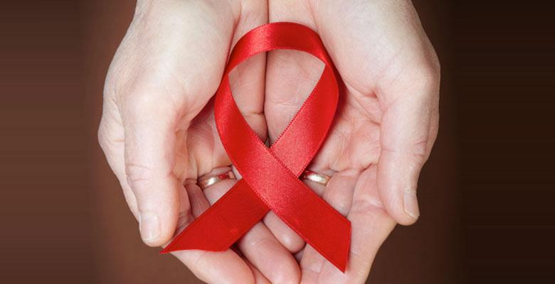
AIDS DAY
Observed every year on December 1st.
WHO established World AIDS Day in 1988.
Raise awareness and focus attention on the global AIDS epidemic.
The red ribbon is the worldwide symbol of support and awareness for people living with HIV.
Notes:
governments, national AIDS programs, faith organizations, community organizations, and individuals

Slide 6
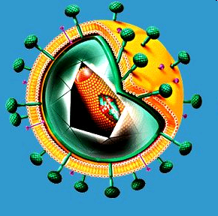
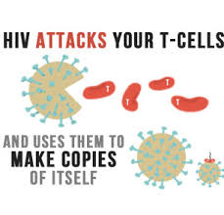
Human immunodeficiency virus.
Attacks the immune system
Virus destroys T-helper cell (CD4 cells)
makes copies of itself inside them.
Notes:
, which is our body’s natural defence against illness…. It becomes harder to fight off infections and diseases. ..TYPE OF WBCS

Slide 7
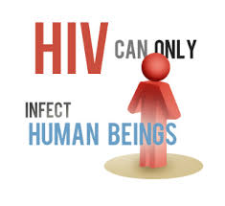

Slide 8
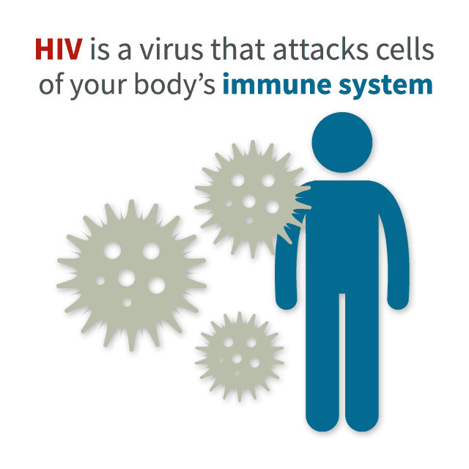
Strains of HIV
The two main types(strains) are:
HIV-1:
The most common type
Found worldwide
HIV-2:
Less common , less infectious than HIV-1
Western Africa, with some cases in India and Europe.

Slide 9
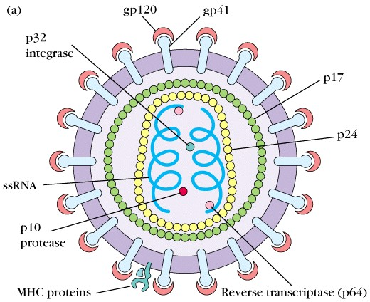
Structure

Slide 10
Genome

Slide 11
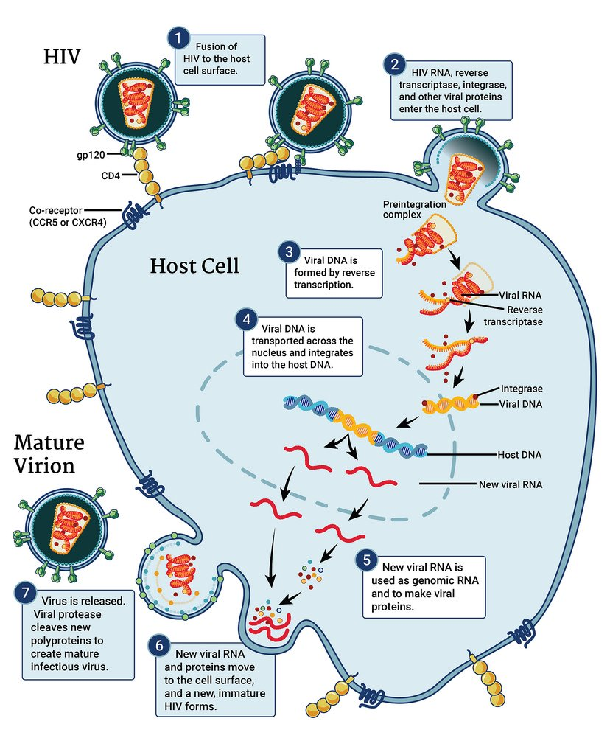
HIV life cycle

Slide 12
Stages of HIV Infection
When people get HIV and don’t receive treatment, they will typically progress through three stages of disease.
Medicine to treat HIV, known as antiretroviral therapy (ART), helps people at all stages of the disease if taken the right way, every day.
Treatment can slow or prevent progression from one stage to the next.
It can also dramatically reduce the chance of transmitting HIV to someone else.

Slide 13
Stage 1: Acute HIV infection
Within 2 to 4 weeks after infection with HIV, people may experience a flu-like illness, which may last for a few weeks.
This is the body’s natural response to infection.
When people have acute HIV infection, they have a large amount of virus in their blood and are very contagious.
But people with acute infection are often unaware that they’re infected because they may not feel sick right away or at all.
To know whether someone has acute infection, either a fourth-generation antibody/antigen test or a nucleic acid (NAT) test is necessary.
If you think you have been exposed to HIV through sex or drug use and you have flu-like symptoms, seek medical care and ask for a test to diagnose acute infection.

Slide 14
Stage 2: Clinical latency (HIV inactivity or dormancy)
This period is sometimes called asymptomatic HIV infection or chronic HIV infection.
During this phase, HIV is still active but reproduces at very low levels.
People may not have any symptoms or get sick during this time. For people who aren’t taking medicine to treat HIV, this period can last a decade or longer, but some may progress through this phase faster.
People who are taking medicine to treat HIV (ART) the right way, every day may be in this stage for several decades.
It’s important to remember that people can still transmit HIV to others during this phase, although people who are on ART and stay virally suppressed (having a very low level of virus in their blood) are much less likely to transmit HIV than those who are not virally suppressed.

Slide 15
Stage 3: Acquired immunodeficiency syndrome (AIDS)
AIDS is the most severe phase of HIV infection.
People with AIDS have such badly damaged immune systems that they get an increasing number of severe illnesses, called opportunistic illnesses.
Without treatment, people with AIDS typically survive about 3 years.
Common symptoms of AIDS include chills, fever, sweats, swollen lymph glands, weakness, and weight loss.
People are diagnosed with AIDS when their CD4 cell count drops below 200 cells/mm or if they develop certain opportunistic illnesses.
People with AIDS can have a high viral load and be very infectious.

Slide 16
Transmission

Slide 17
Transmission
You can get or transmit HIV only through specific activities.
Most commonly, people get or transmit HIV through sexual behaviors and needle or syringe use.
Only certain body fluids—blood, semen pre-seminal fluid, rectal fluids, vaginal fluids, and breast milk—from a person who has HIV can transmit HIV.
These fluids must come in contact with a mucous membrane or damaged tissue or be directly injected into the bloodstream (from a needle or syringe) for transmission to occur.

Slide 18
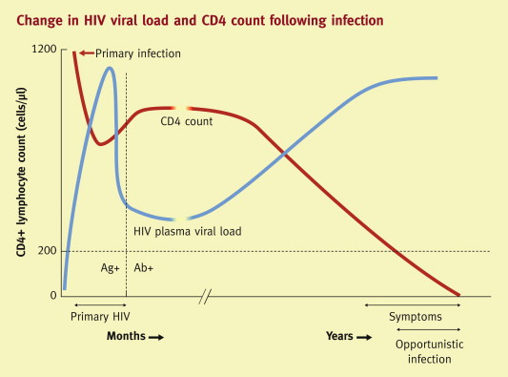

Slide 19
Symtoms
Acute Illness:
Approximately 80 percent of people who contract HIV experience flu-like symptoms within two to four weeks. This flu-like illness is known as acute HIV infection.
body rash
fever
sore throat
severe headaches

Slide 20
Less common symptoms may include:
fatigue
swollen lymph nodes
ulcers in the mouth or on the genitals
muscle aches
joint pain
nausea and vomiting
night sweats
Symptoms typically last one to two weeks.

Slide 21
Asymptomatic period
After the initial symptoms disappear, HIV may not cause any additional symptoms for months or years.
During this time, the virus replicates and begins to weaken the immune system.
A person at this stage won’t feel or look sick, but the virus is still active.
They can easily transmit the virus to others. This is why early testing, even for those who feel fine, is so important.

Slide 22
Advanced infection
It may take some time, but HIV may eventually break down a person’s immune system.
Once this happens, HIV will progress to stage 3 HIV, often referred to as AIDS.
AIDS is the last stage of the disease. A person at this stage has a severely damaged immune system, making them more susceptible to opportunistic infections.
Opportunistic infections are conditions that the body would normally be able to fight off, but can be harmful to people who have HIV.
People living with HIV may notice that they frequently get colds, flu, and fungal infections.

Slide 23
They might also experience the following stage 3 HIV symptoms:
nausea
vomiting
persistent diarrhea
chronic fatigue
rapid weight loss
cough and shortness of breath
recurring fever, chills, and night sweats
rashes, sores, or lesions in the mouth or nose, on the genitals, or under the skin
prolonged swelling of the lymph nodes in the armpits, groin, or neck
memory loss, confusion, or neurological disorders

Slide 24
How do I know if I have HIV
The only way to know for sure whether you have HIV is to get tested. CDC recommends that everyone between the ages of 13 and 64 get tested for HIV at least once as part of routine health care.
Knowing your HIV status gives you powerful information to help you take steps to keep you and your partner healthy.

Slide 25
Testing
There are three broad types of tests available:
antibody tests,
combination or fourth-generation tests,
and nucleic acid tests (NAT). HIV tests may be performed on blood, oral fluid, or urine.
Most HIV tests, including most rapid tests and home tests, are antibody tests.
It can take 3 to 12 weeks (21-84 days) for an HIV-positive person’s body to make enough antibodies for an antibody test to detect HIV infection.

Slide 26
A combination, or fourth-generation, test looks for both HIV antibodies and antigens.
If you’re infected with HIV, an antigen called p24 is produced even before antibodies develop.
Combination screening tests are now recommended for testing done in labs.
There is now a rapid combination test available.
It can take 2 to 6 weeks (13 to 42 days) for a person’s body to make enough antigens and antibodies for a combination, or fourth-generation, test to detect HIV.
A nucleic acid test (NAT) looks for HIV in the blood.
It looks for the virus and not the antibodies to the virus. The test can give either a positive/negative result or an actual amount of virus present in the blood (known as a viral load test).

Slide 27
Cure
No effective cure currently exists for HIV. But with proper medical care, HIV can be controlled.
Treatment for HIV is called antiretroviral therapy or ART. If taken the right way, every day, ART can dramatically prolong the lives of many people infected with HIV, keep them healthy, and greatly lower their chance of infecting others.
Before the introduction of ART in the mid-1990s, people with HIV could progress to AIDS (the last stage of HIV infection) in a few years.
Today, someone diagnosed with HIV and treated before the disease is far advanced can live nearly as long as someone who does not have HIV.

Slide 28
Nucleoside Reverse Transcriptase Inhibitors (NRTI)
Abacavir (Ziagen, ABC)
Didanosine (Videx, dideoxyinosine, ddI)
Emtricitabine (Emtriva, FTC)
Lamivudine (Epivir, 3TC)
Stavudine (Zerit, d4T)
Tenofovir (Viread, TDF)
Zalcitabine (Hivid, ddC)
Zidovudine (Retrovir, ZDV or AZT)

Slide 29
Protease Inhibitors (PI)
These FDA-approved drugs interrupt virus replication at a later step in the virus life cycle. Protease inhibitors include:
Amprenavir (Agenerase, APV)
Atazanavir (Reyataz, ATV)
Fosamprenavir (Lexiva, FOS)
Indinavir (Crixivan, IDV)
Lopinavir (Kaletra, LPV/r)
Ritonavir (Norvir, RIT)
Saquinavir (Fortovase, Invirase, SQV)

Slide 30
Fusion Inhibitors
Fusion inhibitors are a new class of drugs that act against HIV by preventing the virus from fusing with the inside of a cell, preventing it from replicating.
The group of drugs includes
Enfuvirtide, also known as Fuzeon or T-20

Slide 31
Highly Active Antiretroviral Therapy (HAART)
In 1996, highly active antiretroviral therapy (HAART) was introduced for people with HIV and AIDS. HAART — often referred to as the anti-HIV "cocktail" — is a combination of three or more drugs, such as protease inhibitors and other anti-retroviral medications.
The treatment is highly effective in slowing the rate at which the HIV virus replicates itself, which may slow the spread of HIV in the body.
The goal of HAART is to reduce the amount of virus in your body, or the viral load, to a level that can no longer be detected with blood tests

